Slide 1
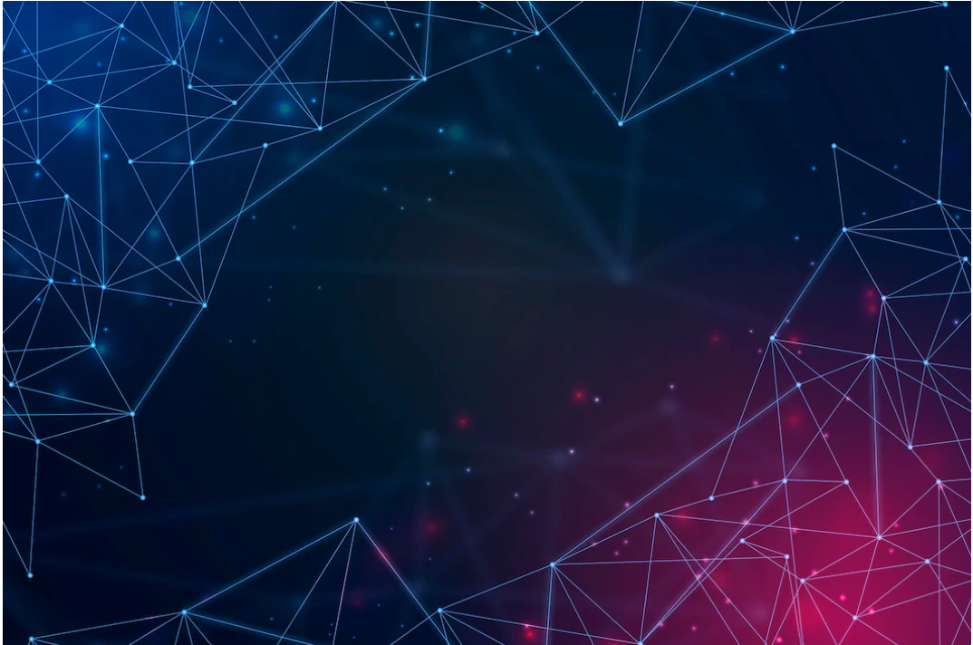
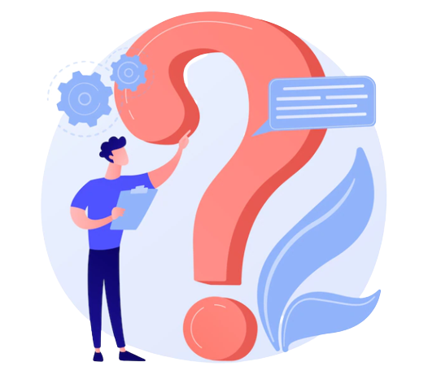
PROBLEM STATEMENT
Language barriers are very much still a real thing.
But what about those that maybe don't speak or can't hear??

Slide 2
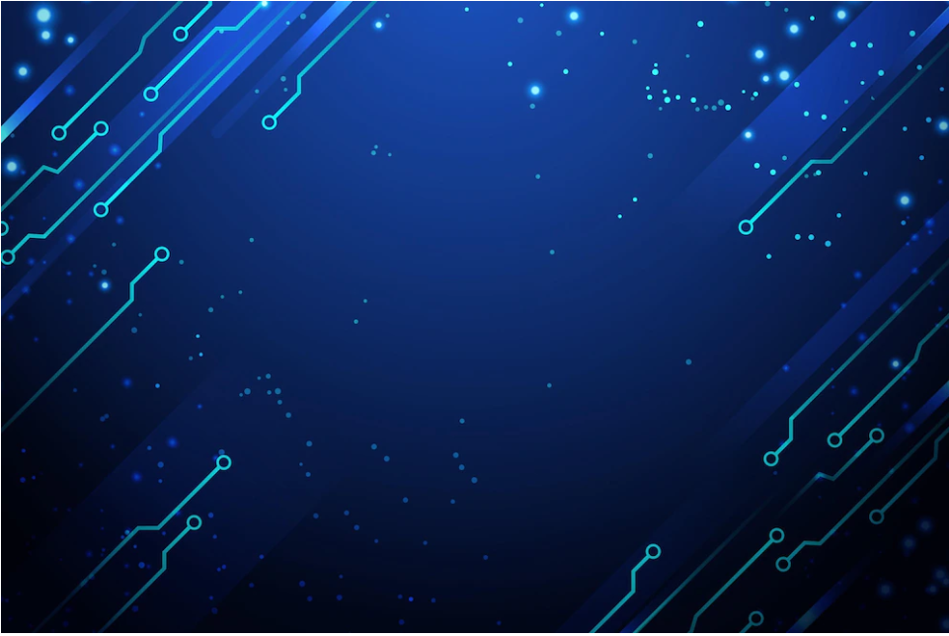
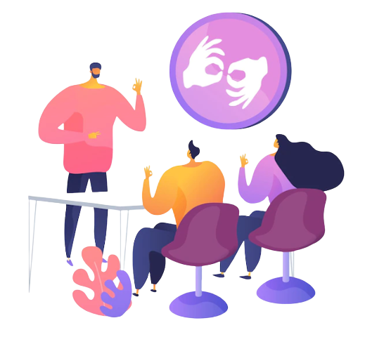
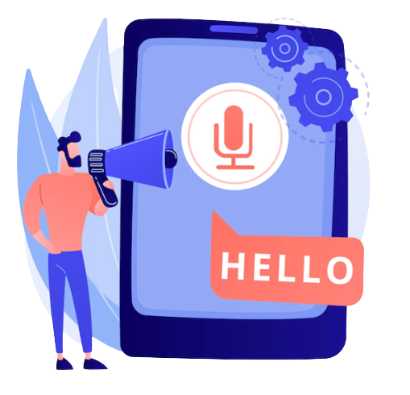
RELATED WORKS

Slide 3
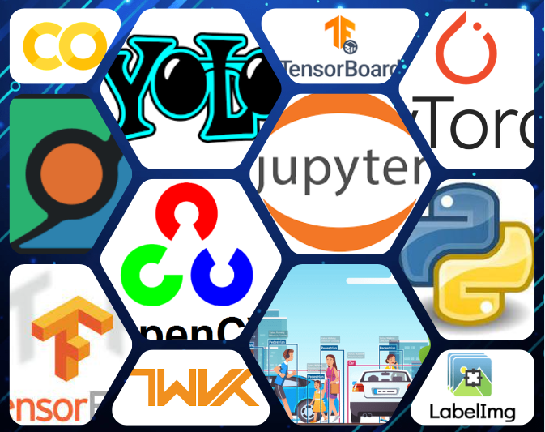
PACKAGES
USED

Slide 4
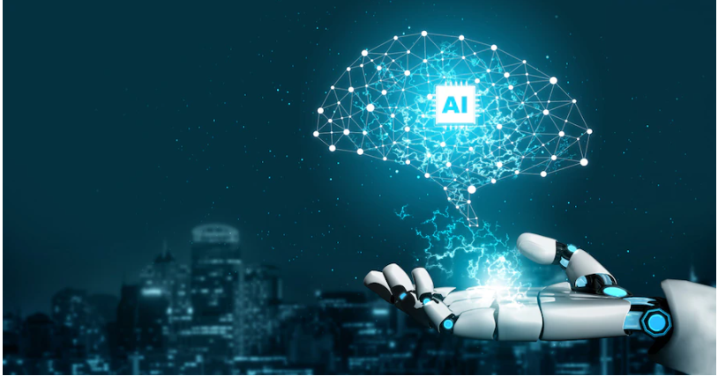
1. COLLECT IMAGES FOR DEEP LEARNING USING YOUR WEBCAM
and OpenCV
2. Label images for sign language detection using Labellmg
3. Setup YAML TO GET YOLO & TENSORFLOW BOARD
4. Use YOLO V5 to train a deep learning model
5. Detect sign language in real time using OpenCV

Slide 5
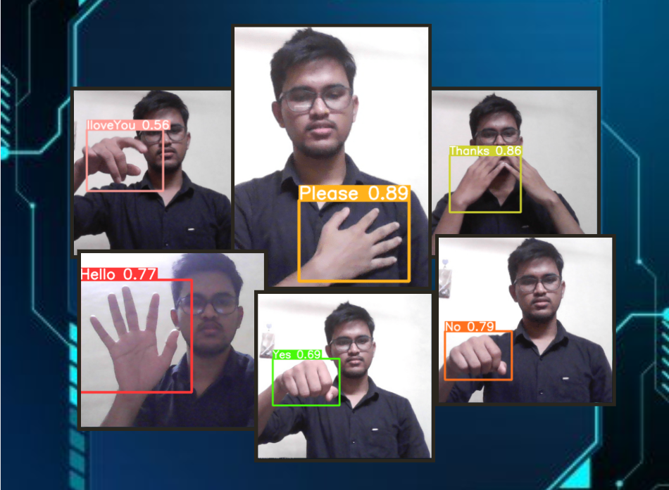
OUTCOME
SOFTWARE

Slide 6
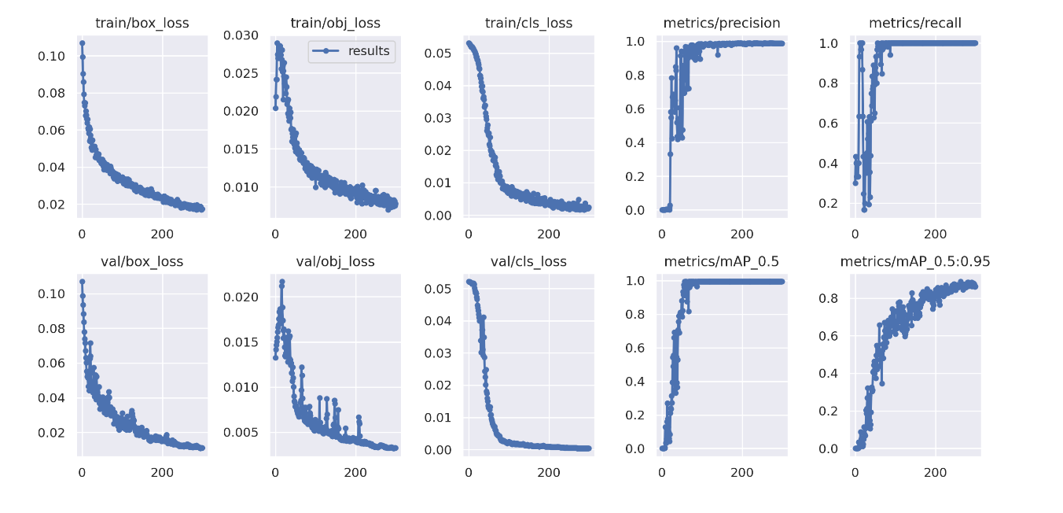
TENSORBOARD RESULTS

Slide 7
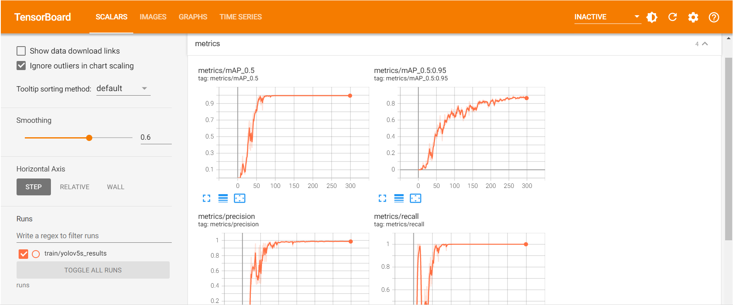

Slide 8
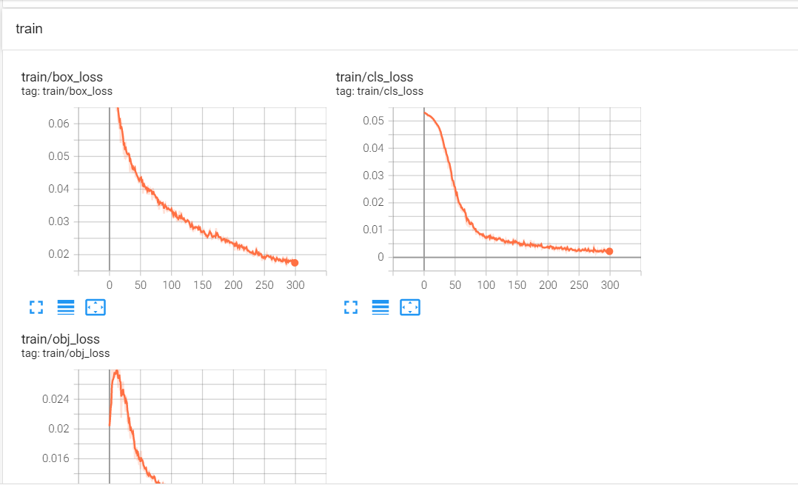

Slide 9
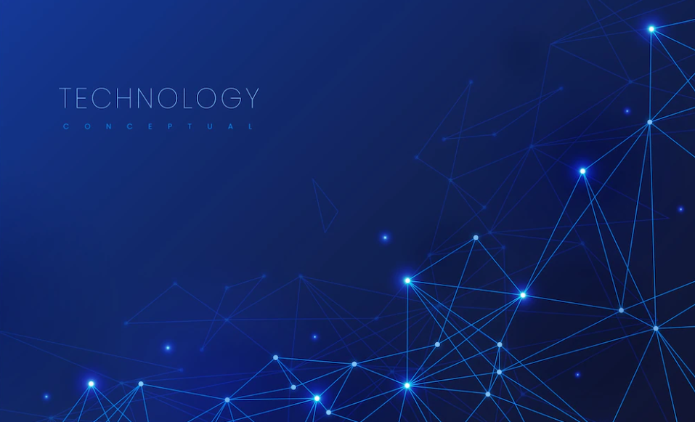
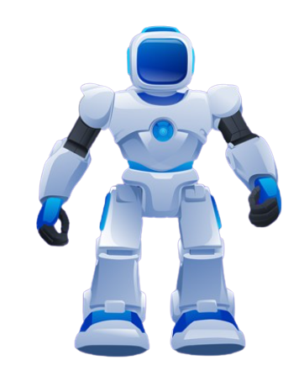
Thank
you!

